Slide 1
The “Roaring Twenties”
Unit 6

Slide 2
Adjusting to the Peace 1919-1921

Slide 3
Adjusting to the Peace 1919-1921
America returned to foreign policy of isolationism
Immediately after the war, Americans experienced a temporary recession as businesses adjusted from a wartime to a peacetime economy

Slide 4
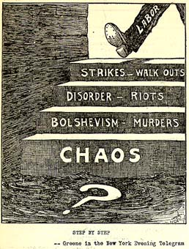
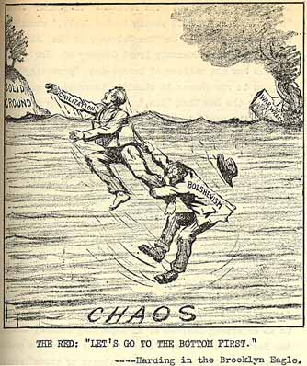
Adjusting to the Peace 1919-1921
Red Scare
Americans were frightened by the triumph of Bolsheviks & Communism in Russia led to Red Scare in USA
Fear of Communist Revolutions in US

Slide 5
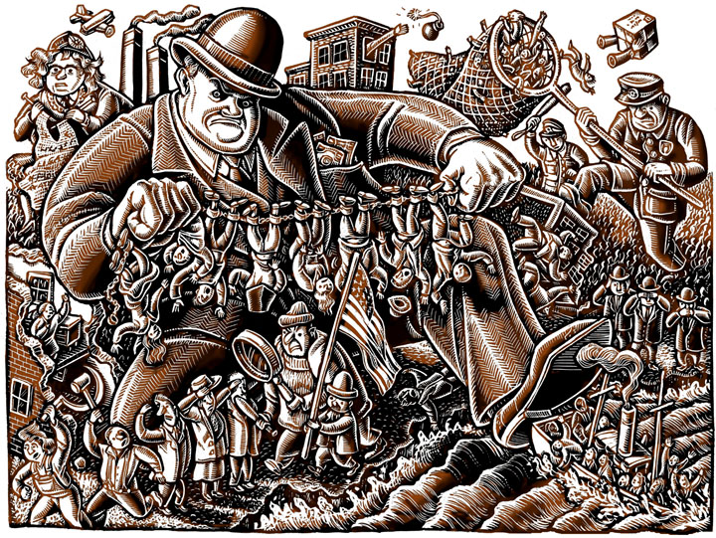
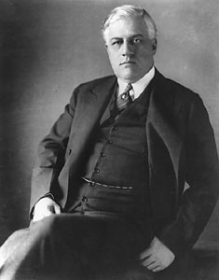
Adjusting to the Peace 1919-1921
Palmer Raids—Attorney General Palmer arrested thousands of suspects and deported them

Slide 6
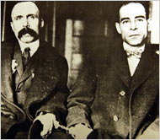
Adjusting to the Peace 1919-1921
Trial of Sacco & Vanzetti
Nicola Sacco and Bartolomeo Vanzetti—convicted and executed of a robbery in part because of the hysteria against foreigners

Slide 7
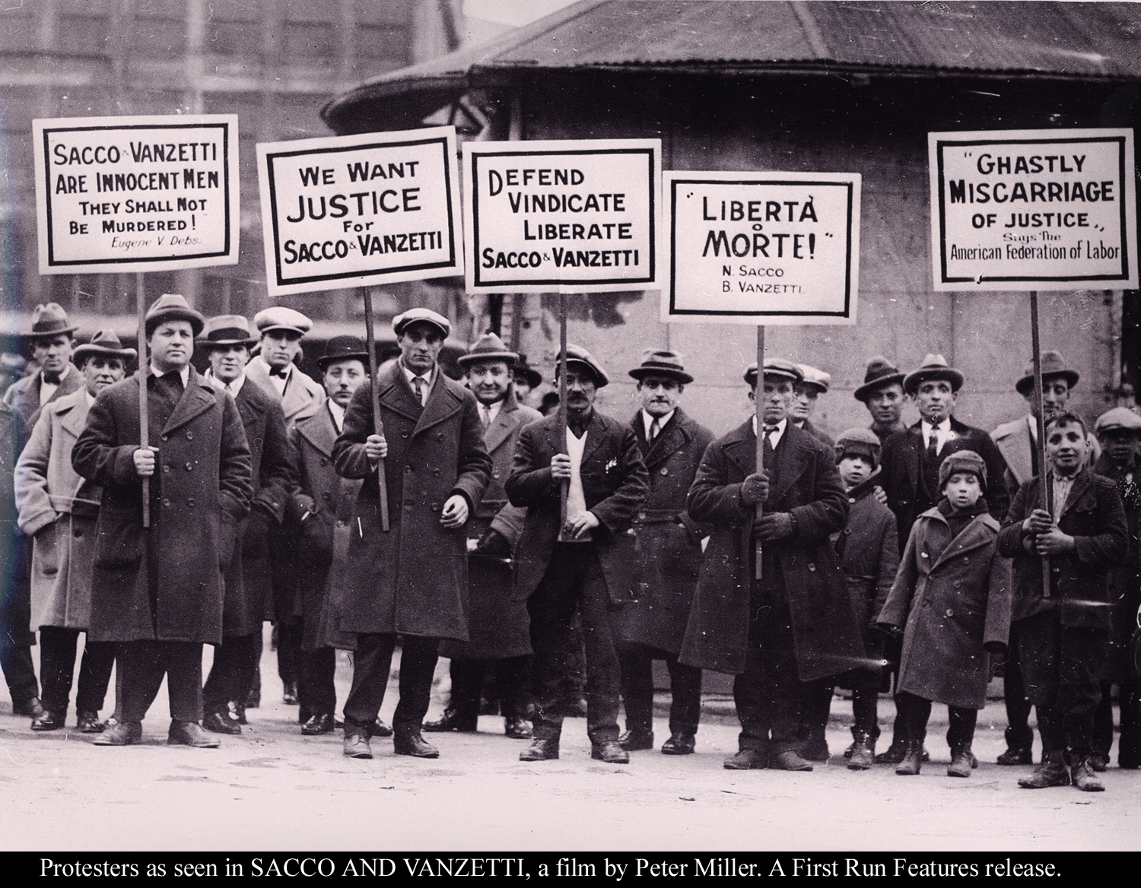
Sacco and Vanzetti
The case of Sacco and Vanzetti symbolized Americas fear of immigrants, communists and anarchists

Slide 8
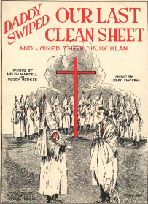
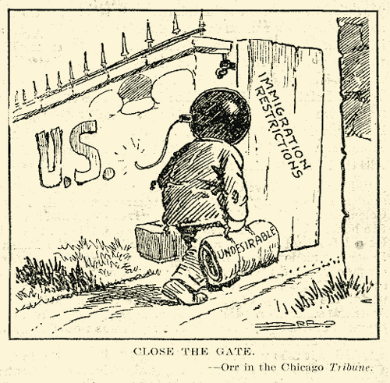
Adjusting to the Peace 1919-1921
Rise of Nativism and Racism
Nativism and racism were also on the rise as US retreats into a traditional isolationist foreign policy
Distrust of Foreigners (White Protestant American superiority)
Rise of the KKK (Hostile to Jews, Catholics, immigrants and African Americans) (Ku Klux Klan)

Slide 9
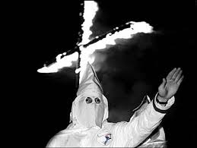

Slide 10
Unit 6 The 1920’s
Three Republican Presidents: Harding, Coolidge, Hoover

Slide 11
Three Republican Presidents: Harding, Coolidge, Hoover
Policies favoring business
Lower taxes on corporations (lower taxes for the rich & corporations, shifts to middle class)
High protective tariffs (Hawley-Smoot Tariff—highest tariff in US history, used to keep foreign goods out)
lax enforcement of Antitrust laws and regulations (allowed to merge without govt regulation)

Slide 12
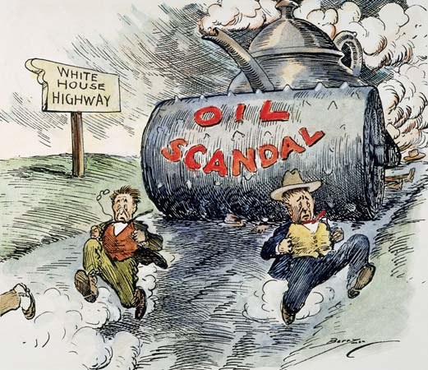
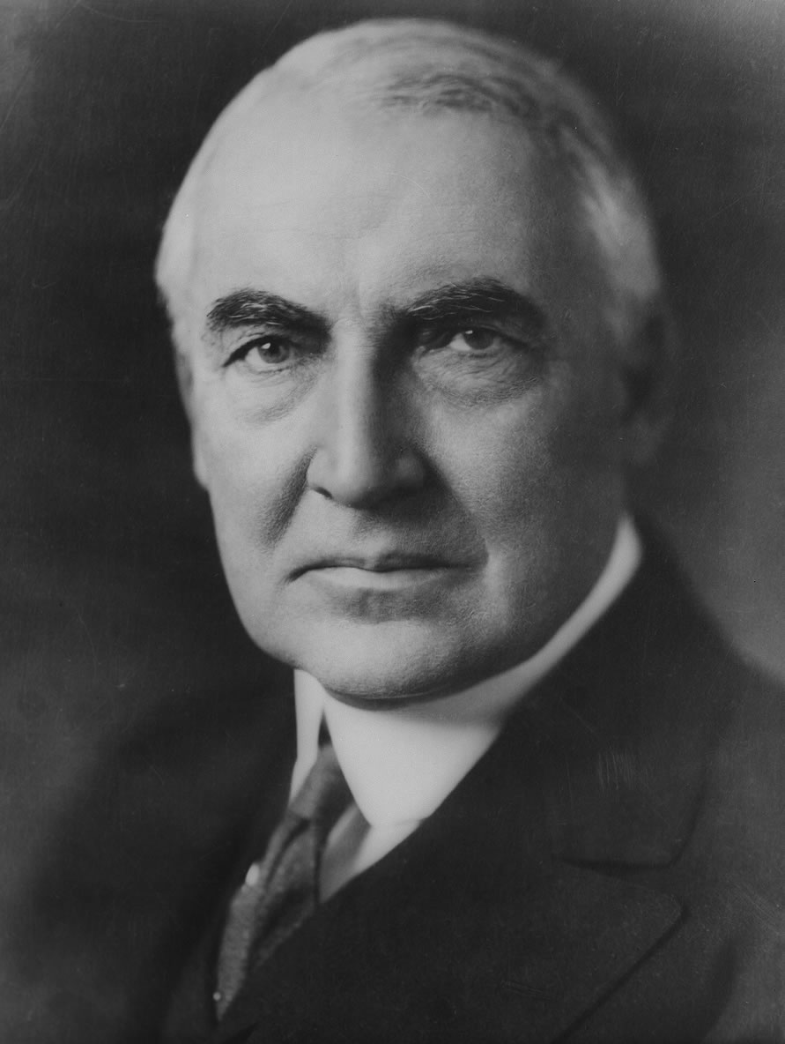
Three Republican Presidents:Harding
The Harding Administration 1921-1923
Sought a “Return to Normalcy” after WWI (emphasis on domestic policy & economic prosperity in US)
Administration beset by corruption with various scandals
Teapot Dome Scandal--leased govt land rich in oil to business friends for a bribe

Slide 13
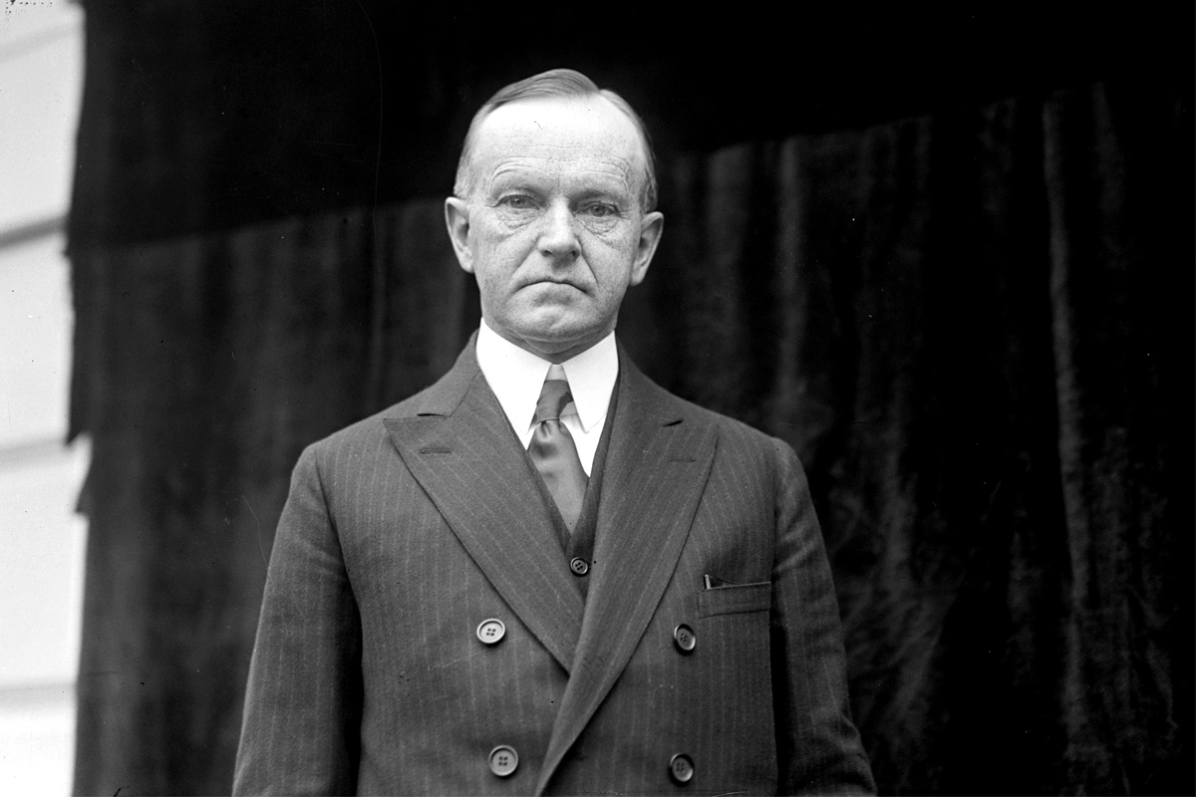
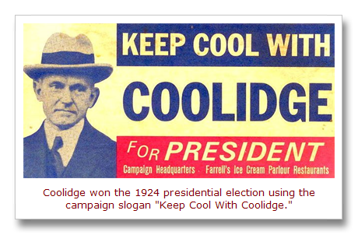
Three Republican Presidents:Coolidge
The Coolidge Administration 1923-1929
No right to strike against the public safety (Police strike of 1919)
Believed business of America is business
Strong pro business policies
Allowed large business expansion

Slide 14
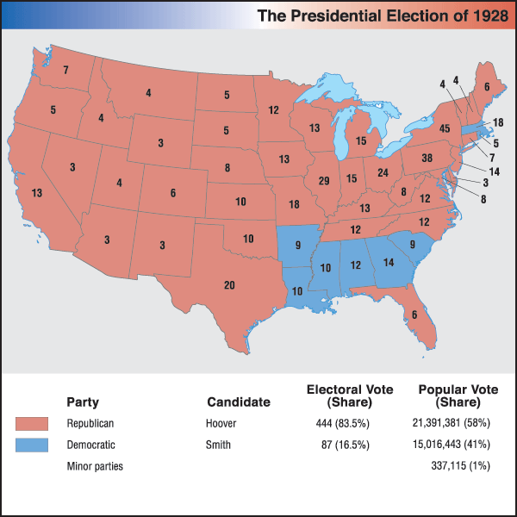
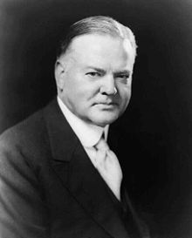
Three Republican Presidents:Hoover
The Hoover Administration 1929-1933
Engineer who organized food production in World War I
Secretary of Commerce
As president predicted an end to poverty which helped get him elected

Slide 15
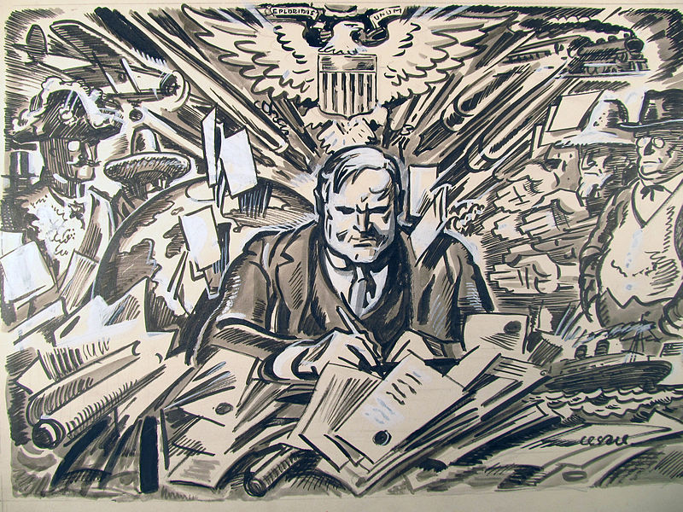
Three Republican Presidents:Hoover
Believed in “rugged individualism” spirit that made US a great nation (equal opportunity, free education, will to succeed)
Strongly Pro business (raised US standard of living)
Felt that govt interference in the economy should be minimal (cause corruption & extinguish opportunity)

Slide 16
OTD
1. Which president wanted a ‘return to normalcy’? 2. Which president became president because he was VP to a president that died in office?
3. Which president’s term was full of scandal (tea pot dome)?
4. what is a distrust of foreigners?
5. What is the name of the ‘hate group’ that disliked Jews and Catholics?
6. What do we call the fear of communism in the 1920s?

Slide 17
Unit 6 The “Roaring Twenties”
Reasons for Prosperity of the 1920’s

Slide 18
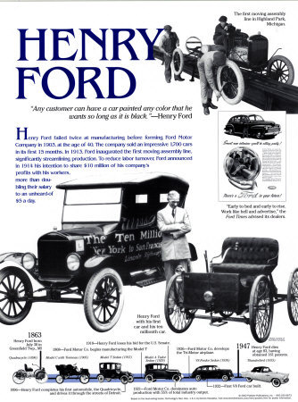
Reasons for Prosperity of the 1920’s
The Rise of the Automobile
Cars allowed greater mobility to people (vacations, suburbs, schooling)
Stimulated other industries (gas, rubber, steel)
Single most important factor for prosperity of 1920’s

Slide 19
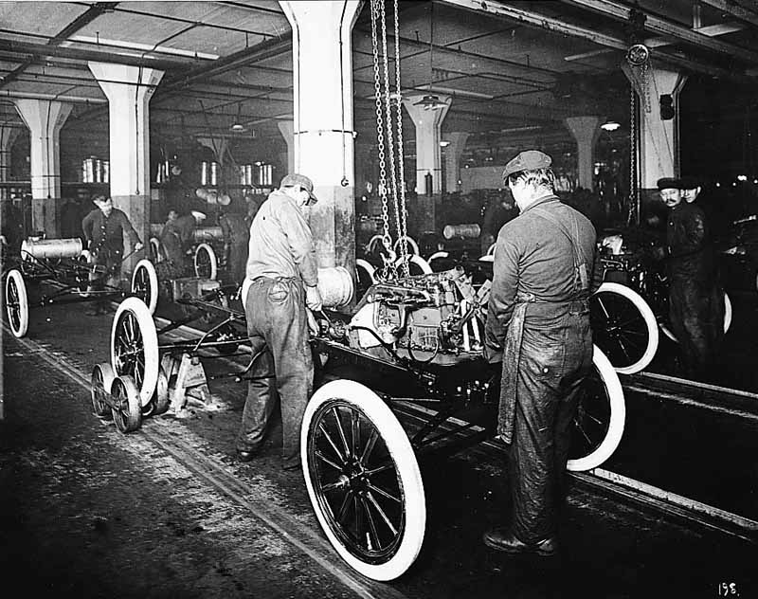
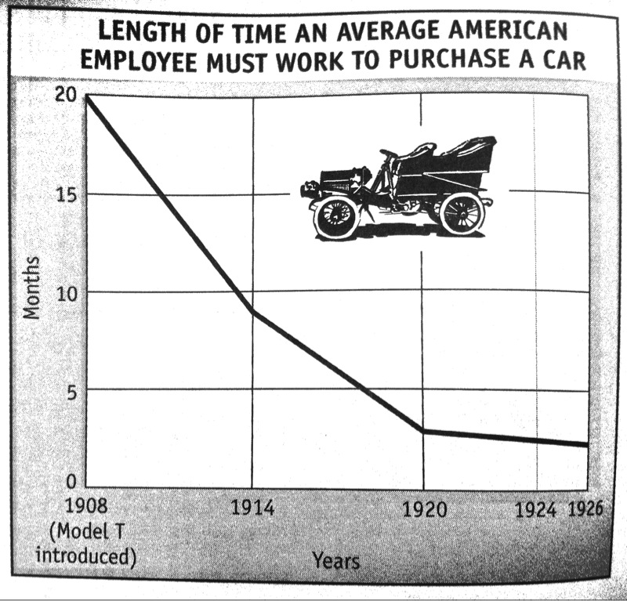
Reasons for Prosperity of the 1920’s
Henry Ford—early auto manufacturer who pioneered new production techniques such as assembly line to lower car prices and bring car ownership within reach of most Americans
Model T priced at under $300 per car, allowed everyone to afford a car

Slide 20
Reasons for Prosperity of the 1920’s
New Industries
Electricity and electrical appliances stimulate economy:
radio
motion picture
vacuum cleaners
Created new jobs and changed the way Americans lived

Slide 21
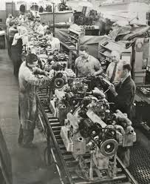
Reasons for Prosperity of the 1920’s
More Efficient Production Techniques
Assembly line
Standardized parts
Conveyer belt
Increased efficiency and production speed, did away with skilled workers

Slide 22
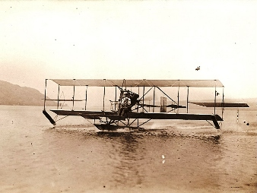
Reasons for Prosperity of the 1920’s
Aviation
Glenn Curtiss—aviation pioneer who developed airplanes that landed on water

Slide 23
Emergence of New values in the 1920’s
Rise of Popular new Heroes
More leisure time in 1920’s leads to greater need for entertainment and heroes to identify with
Charles Lindbergh-first person to fly solo across the Atlantic ocean
Became an international hero
Sports stars like Babe Ruth and Jack Dempsey serve as role models

Slide 24
Reasons for Prosperity of the 1920’s
Age of Mass Consumption
Advertising stimulated demand (higher wages and leisure time lead to mass purchasing)
Retailers introduced installment buying & buying on credit

Slide 25
Reasons for Prosperity of the 1920’s
Speculation Boom & Uneven Prosperity
Corporate profits led stock prices to rise
Many Americans began to speculate in the stock market and real estate in the hopes of getting rich
Top 1% controlled almost 50% of wealth in US

Slide 26
Many historians believe the mass-production of automobiles was the most important factor in the prosperity of the 20s. Do you agree? Explain your answer
Did the use of buying on credit make the economy fragile? Explain.
Recreate the Factors of Prosperity graphic organizer on pg 183 of Jarrett book and fill in.

Slide 27
Reasons for Prosperity
Those who were not so prosperous: immigration and eugenics

Slide 28
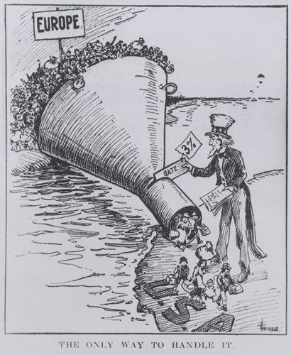
Cultural Values in Conflict in the 1920’s (Attempts to Preserve Traditional Values)
New Restrictions on Immigration
Growth in Nativist sentiment
Immigration acts of 1921, 1924, 1929, used to keep out immigrants from Southern & Eastern Europe
establish immigrant quotas for the 1st time

Slide 29
Cultural Values in Conflict in the 1920’s (Attempts to Preserve Traditional Values)
Eugenics
advocated improvement by breeding (superior race)
promote superior genetic characteristics and Social Darwinism
Used to advocate reducing immigration, forced sterilization, segregation, and marriage restrictions

Slide 30
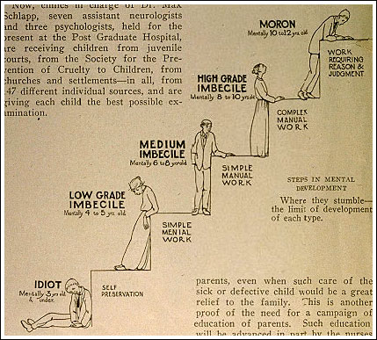
Eugenics

Slide 31
Emergence of New values
Harlem Renaissance, The Great Migration, and the Lost Generation

Slide 32
Emergence of New values in the 1920’s
Tin Pan Alley
Located in NYC
Emergence of new form of American Popular music (blues, jazz, ragtime mixed together)
Led to new song writers and new need to play songs at home

Slide 33
Emergence of New values in the 1920’s
Youth and Lost Generation
Rejected desire for material wealth
Influenced by brutality of WWI, felt that US had become materialistic and lacked spirituality

Slide 34
Emergence of New values in the 1920’s
Sinclair Lewis ridiculed American hypocrisy in his books Main Street & Babbitt
F. Scott Fitzgerald—his works such as The Great Gatsby, captured the spirit of the Jazz Age and depicted the lifestyles of the young and materialistic rich in the 1920’s
Ernest Hemingway—wrote about experiences of WWI and the strength of youth in A Farewell to Arms and The Sun also Rises

Slide 35
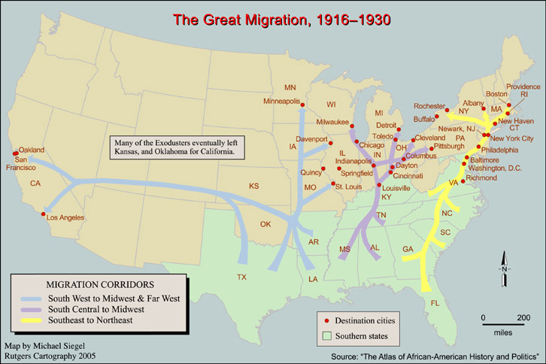
Emergence of New values in the 1920’s
The Great Migration
Millions of African Americans leave the south and migrate to northern and Midwestern cities during and after WWI
Went to look for jobs in industry and to escape racism

Slide 36
Emergence of New values in the 1920’s
The Harlem Renaissance
Began with the Rise of Jazz music
Led to new optimism and growth of African American culture
Harlem, New York became cultural center of the Harlem Renaissance

Slide 38
Emergence of New values in the 1920’s
Langston Hughes (Poet and Novelist)—wrote about pride in black heritage and attacked racism
Alain Locke: Black Historian who collected works of Harlem Renaissance
Zora Hurston: wrote Their Eyes Watching God
All celebrated black culture and value through their works

Slide 39
Langston Hughes
Song for a Dark Girl
Way Down South in Dixie
(Break the heart of me)
They hung my black young lover
To a cross roads tree.
Way Down South in Dixie
(Bruised body high in air)
I asked the white Lord Jesus
What was the use of prayer.
Way Down South in Dixie
(Break the heart of me)
Love is a naked shadow
On a gnarled and naked tree

Slide 40
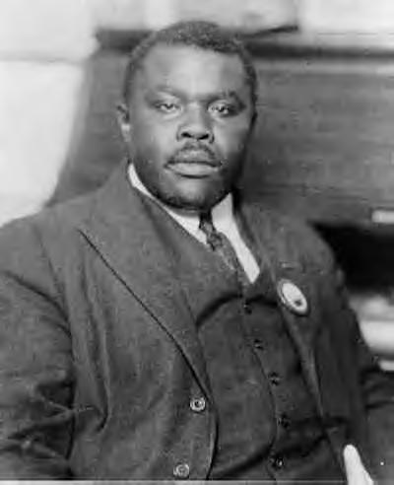
Emergence of New values in the 1920’s
Marcus Garvey
Wanted African Americans to organize for freedom
Believed in black self help by owning businesses
Leader of Back to Africa Movement

Slide 41
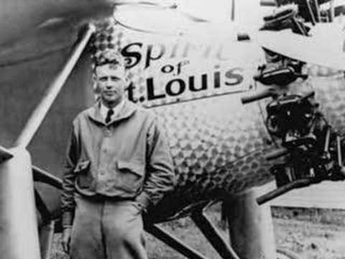

Slide 42
Unit 6 Acrostic Review
To review what we talked about in Ch 13 you will create an acrostic poem
You will use the following word to create your poem: Jazz Age
Jumpstarted a new age of American heroes by flying solo across the Atlantic
A
Z
Z
A
G
E
You must explain the importance of the following terms below in your poem, making sure to include as much detail as possible.
You must include the following: Charles Lindbergh, Flappers,
Harlem Renaissance, Prohibition, Scopes Trial, Clarence Darrow, William Jennings Bryan
Your sentences have to be at least five words and not more than 15:
When you are finished raise your hand and I will check your work, you must get you work checked before you leave

